Slide 1




Noida Institute of Engineering and Technology, Greater Noida
Introduction
Unit: 1
Software Engineering
ACSE0603
Ms.Renu Devi
Assistant Professor CSE (AIML)
(B Tech VIth Sem)

Slide 2
Faculty Profile
Name of the faculty : Ms.Renu Devi Designation & Department : Assistant Professor (CSE-AIML) Qualification : B.tech , M.tech , PH.D ( Pursuing ) Experience : I have a 12+ years of teaching experience in engineering college,I Have taught
subjects Python Programming,C Language, Software Engineering,Design Pattern,
Artificial Intelligence,Mahine Learning.

Slide 3
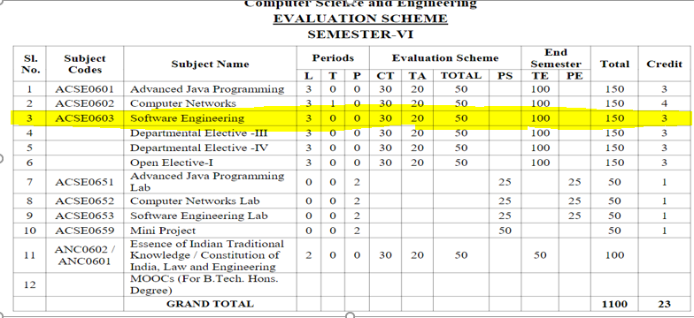
Evaluation Scheme

Slide 4
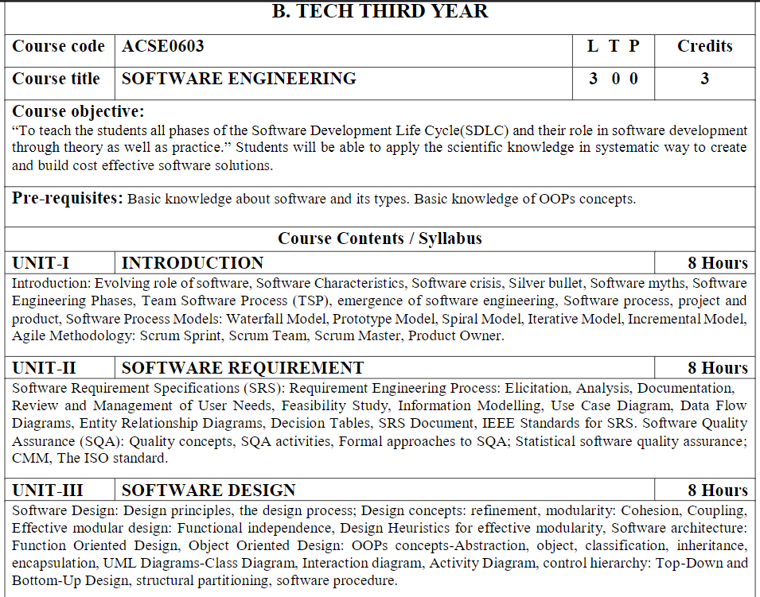
Syllabus

Slide 5
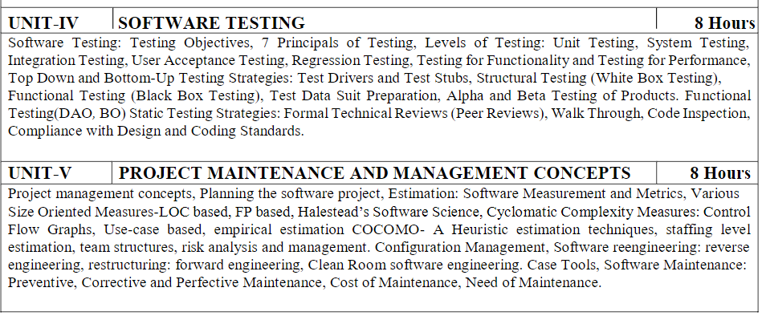
Syllabus

Slide 6
Branch wise Application
Business software.
Accounting software.
Analytics.
Decision support systems.
Airline reservations.
Banking, Automated teller machines, Cheque processing.
Commerce, Trade, Auctions (e.g. eBay)
Compilers
Animation.

Slide 7
Course Objective
To enable students to develop methods and procedures for software development that can scale up for large systems and that can be used consistently to produce high-quality software at low cost and with a small cycle of time.
Students will be able to understand the concepts of requirement engineering, designing and its principles, testing techniques and maintenance methods for effective software development.

Slide 8
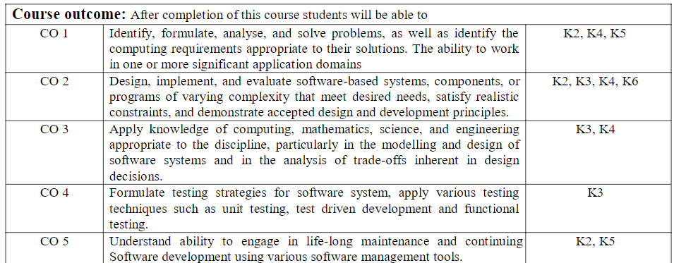
Course Outcome

Slide 9
Program Outcome
PO1: Engineering Knowledge
PO2: Problem Analysis
PO3: Design/Development of solutions
PO4: Conduct Investigations of complex problems
PO5: Modern tool usage
PO6: The engineer and society
PO7: Environment and sustainability
PO8: Ethics
PO9: Individual and team work
PO10: Communication
PO11: Project management and finance
PO12: Life-long learning

Slide 10
CO-PO Mapping
CO-PO Correlation Matrices
Correlation levels are taken 1, 2 and 3 as defined below:
1: Slight (Low) 2: Moderate (Medium) 3: Substantial (High)
Sr. No | Course Outcome | PO1 | PO2 | PO3 | PO4 | PO5 | PO6 | PO7 | PO8 | PO9 | PO10 | PO11 | PO12
1 | ACSE0603.1 | 3 | 3 | 2 | 2 | 2 | - | - | - | - | - | - | 1
2 | ACSE0603.2 | 3 | 3 | 3 | 3 | 2 | - | - | 2 | 2 | 1 | - | 2
3 | ACSE0603.3 | 3 | 3 | 3 | 3 | 2 | - | 1 | 2 | 2 | 1 | 2 | 2
4 | ACSE0603.4 | 3 | 3 | 3 | 3 | 2 | 2 | 1 | 2 | 2 | 1 | 2 | 2
5 | ACSE0603.5 | 3 | 3 | 3 | 3 | 2 | 3 | 2 | - | 3 | 3 | 2 | 3
6 | Average | 3.0 0 | 3.00 | 2.80 | 2.80 | 2.00 | 1.00 | 0.80 | 1.20 | 1.80 | 1.20 | 1.20 | 2.00

Slide 11
Program Specific Outcomes(PSO)
S.NO. | Program Specific Outcomes | PSO Description
1 | PSO1 | The ability to identify, analyze real world problems and design their ethical solutions using artificial intelligence, robotics, virtual/augmented reality, data analytics, block chain technology, and cloud computing.
2 | PSO2 | The ability to design and develop the hardware sensor devices and related interfacing software systems for solving complex engineering problems.
3 | PSO3 | The ability to understand inter-disciplinary computing techniques and to apply them in the design of advanced computing.
4 | PSO4 | The ability to conduct investigation of complex problems with the help of technical, managerial, leadership qualities, and modern engineering tools provided by industry-sponsored laboratories.

Slide 12
CO-PO and PSO Mapping
 | PSO1 | PSO2 | PSO3 | PSO4
ACSE0603.1 | 3 | 3 | 3 | 3
ACSE0603.2 | 3 | 3 | 3 | 3
ACSE0603.3 | 2 | 2 | 2 | 2
ACSE0603.4 | 3 | 3 | 3 | 3
ACSE0603.5 | 2 | 2 | 2 | 2
Average | 2.6 | 2.6 | 2.6 | 2.6

Slide 13
Program Educational Objectives (PEOs)
PEO 1: Apply sound knowledge in the field of Information Technology to full the needs of IT industry.
PEO 2: Design innovative and interdisciplinary systems through latest digital technologies.
PEO 3: Inculcate professional – social ethics, team work and leadership for serving the society.
PEO 4: Inculcate lifelong learning in the field of computing for successful career in organizations and R&D sectors.

Slide 14
Result Analysis
Subject Result = Not declared Yet.

Slide 15
End Semester Question Paper Templates
B TECH
(SEM-V) THEORY EXAMINATION 20__-20__
SOFTWARE ENGINEERING
Time: 3 Hours Total Marks: 100
Note: 1. Attempt all Sections. If require any missing data; then choose suitably.
SECTION A
Attempt all questions in brief. 1 x 10 = 10
Q.No. | Question | Marks | CO
1 |  | 2
2 |  | 2
3 |  | .
4 |  | 2

Slide 16
End Semester Question Paper Templates
SECTION A
2. Attempt all questions in brief. 2 x 5 = 10
Q.No. | Question | Marks | CO
1 |  | 2
2 |  | 2
3 |  | .
4 |  | 2

Slide 17
End Semester Question Paper Templates
SECTION B
3. Attempt any five of the following: 5 x 6 = 30
SECTION C
4. Attempt any one part of the following: 1 x 10 = 10
Q.No. | Question | Marks | CO
1 |  | 6
2 |  | 6
. |  | .
7 |  | 6
Q.No. | Question | Marks | CO
1 |  | 10
2 |  | 10

Slide 18
Prerequisite and Recap
Basic knowledge about software and its types.
Basic knowledge of any programming language.

Slide 19
Brief Introduction about the subject with Video
Software Engineering is a systematic, disciplined, quantifiable study and approach to the design, development, operation, and maintenance of a software system.
Software engineering applications are new idea, device or process. Innovations are the application of better solutions that meet new requirements, inarticulated needs or existing market needs.
https://www.youtube.com/watch?v=kcvEiMFOcoE
https://www.youtube.com/watch?v=WxkP5KR_Emk

Slide 20
Unit Content
Introduction:
Evolving role of Software
Software Characteristics
Software Crisis
Silver Bullet
Software Myths
Software Process
Software Engineering Phases
Team Software Process (TSP)
Emergence of Software Engineering
Software process, Project and Product.

Slide 21
Unit Content
Software Process Models:
SDLC
Waterfall Model
Prototype Model
Spiral Model
Iterative Model
Incremental Model
V Process Model
Agile Methodology

Slide 22
Unit Objective
In this unit, students will gain the understanding the basic concept of software engineering and its application. A general understanding of software development life cycle such as waterfall, prototype, spiral model. An ability to identify, formulate and solve engineering problems.

Slide 23
Topic Objective
Topic | Objective
Software Crisis | To understand the software crisis
Software Emergence | To study the software emergence
SDLC | To draw the SDLC diagrams
Agile Methodology | To study the different Agile Methodologies

Slide 24
What is Software (CO1)
Software is
A program along with proper documentation (requirement analysis, design, coding, testing) and user manuals which includes installation guide and other manuals.

Slide 25
What is Software? IEEE Definition
IEEE definition of Software:-
Software is the collection of computer programs procedures, rules and associated documentation and data.
“IEEE : Institute of Electrical and Electronics Engineers”

Slide 26
Importance of Software
It has become a driving force.
It is engine that drive business decision making.
It serve as the basis for modern scientific investigation and engineering problem solving.
It is embedded in all kind of systems like transportation , medical, telecommunications, military, industrial process, entertainment, office products

Slide 27
Importance of Software
It affects nearly every aspect of our lives and has become pervasive in our commerce, our culture and our every day activities software impact on our society and culture is significant .
As software importance grows, the software community continually attempts to develop technologies that will make it easier faster and less expensive to build high quality computer programs.

Slide 28
Introduction to Software Engineering
IEEE Definition:-
Software Engineering is the application of systematic, disciplined, quantifiable approach to the development, operation and maintenance of software.
or
Software Engineering Is an Engineering discipline which is concerned with all aspects of software production.

Slide 29
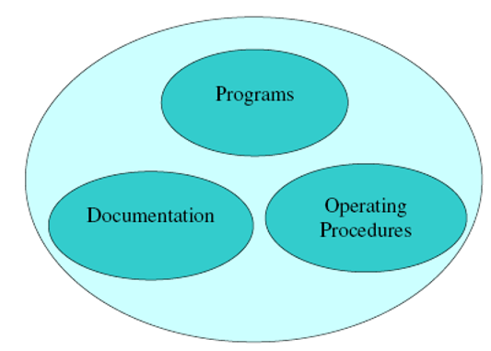
Software Components
Software components comprises of these 3 components :

Slide 30
Objective of software Engineering
The basic objective of software engineering is to develop methods and procedures for software development that can scale up for large systems and that can be used consistently to produce high-quality software at low cost and with a small cycle of time

Slide 31
Software Characteristics (CO1)
The key characteristics of software are -
Most software is custom built, rather than being assembled from existing components.
Software is developed or engineered; It is not manufactured in the classical sense.
Software is flexible and new functionalities can be added on later.
Software doesn’t wear out.

Slide 32
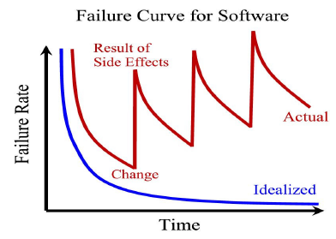
Software vs Hardware
Software does not have wear out phase
Figure: Software does not have wear out

Slide 33
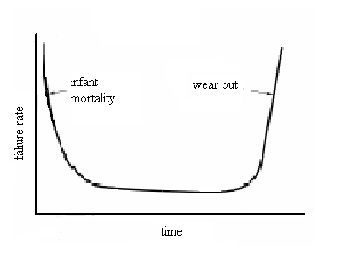
Software vs Hardware
Failure rate of hardware
Figure: Failure rate of hardware

Slide 34
Software vs Hardware
We don’t have this phase for the software as it does not wear out.
Important point is software becomes reliable overtime instead of wearing out
It becomes obsolete.
Software may be retired due to environmental changes , new requirement and new expectation

Slide 35
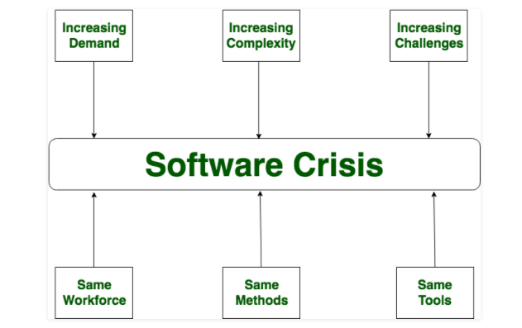
Software Crisis
Software Crisis :
It is a term used in computer science for the difficulty of writing useful and efficient computer programs in the required time.
Software crisis was due to using same workforce, same methods, same tools even though rapidly increasing in software demand, complexity of software and software challenges.
With increase in the complexity of software, many software problems arise because existing methods were insufficient.

Slide 36
Software Crisis
The software crisis in software engineering refers to challenges that emerged as software development outpaced methodologies and tools. In the 1960s, growing complexity led to missed deadlines, budget overruns, and buggy systems.
Reasons for Software Crisis in Software Engineering
Complexity Overload
Lack of Formalization
Changing Requirements
Insufficient Quality Assurance
Limited Reusability
Poor Project Management
Rapid Technological Advancements

Slide 37
Software Crisis
Solutions to the Software Crisis
Structured Methodologies:
Formal Software Development:
Requirements Engineering:
Quality Assurance and Testing:
Code Reusability:
Improved Project Management:
Standardization and Best Practices:

Slide 38
No Silver Bullet(CO1)
The term "silver bullet" in software engineering refers to the idea of a simple and universally applicable solution that can solve a complex problem effortlessly and efficiently.
“There is no single development, in either technology or management technique, which by itself promises even one order-of-magnitude improvement within a decade in productivity, in reliability, in simplicity.”• — Fred Brooks, 1986

Slide 39
No Silver Bullet(CO1)
Brooks divides the problems facing software engineering into two categories
• essence: difficulties inherent, or intrinsic, in the nature of software
• accidents: difficulties related to the production of software
Brooks argues that most techniques attack the accidents of software engineering
An Order of Magnitude
In order to improve software development by a factor of 10
• first, the accidents of software engineering would have to account for 90% of the overall effort
• second, tools would have to reduce accidental problems to zero

Slide 40
No Silver Bullet(CO1)
Brooks divides the essence into four subcategories
• complexity
• conformity
• changeability
• invisibility
Complexity of software systems is rather interesting as it is desired and not accidental and yet constitutes most of the monstrosity of software systems.
Conformity is a necessary evil and normally has no logic to it but, for organizational restrictions.
Changeability again is a constant sword hanging over software systems.
Invisibility refers to the fact that there isn’t any tool that can physically and convincingly represent a software system and this limits us mostly.

Slide 41
Software Myth (CO1)
What is Software Myth?
Beliefs about software and the process used to build it. Software myths are misleading attitudes that have caused serious problems for managers and technical people alike. Software myths propagate misinformation and confusion.
Types of Software Myth-
There are 3 types of Software Myth-
Management Myth
Customer Myth
Practitioner’s Myth

Slide 42
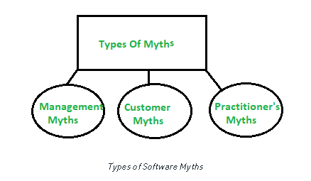
Software Myth (CO1)

Slide 43
Software Myth (CO1)
Management Myths :
Myth 1:
We have all the standards and procedures available for software development i.e. the software developer has all the requirements.
Fact :
Software experts do not know all the requirements for software development.
And all existing processes are incomplete as new software development is based on new and different problem.
.

Slide 44
Software Myth (CO1)
Myth 2 :
The addition of the latest hardware programs will improve the software development.
Fact:
The role of the latest hardware is not very high on standard software development; instead (CASE) Engineering tools help the computer, they are more important than hardware to produce quality and productivity.
Hence, the hardware resources are misused.
Myth 3 :
Managers think that, with the addition of more people and program planners to Software development can help meet project deadlines (If lagging behind).
Fact: If software is late, adding more people will merely make the problem worse. This is because the people already working on the project now need to spend time educating the newcomers, and are thus taken away from their work. The newcomers are also far less productive than the existing software engineers, and so the work put into training them to work on the software does not immediately meet with an appropriate reduction in work.

Slide 45
Software Myth (CO1)
(ii)Customer Myths :
The customer can be the direct users of the software, the technical team, marketing / sales department, or other company. Customer has myths leading to false expectations (customer) & that’s why dissatisfaction with the developer is created.
Myth 1 :
A general statement of intent is enough to start writing plans (software development) and details of objectives can be done over time.
Fact:
Official and detailed description of the database function, ethical performance, communication, structural issues and the verification process are important.
Unambiguous requirements (usually derived iteratively) are developed only through effective and continuous communication between customer and developer.

Slide 46
Software Myth (CO1)
Myth 2 :
Project requirements continue to change, but, change, can be easy location due to the flexible nature of the software.
Fact :
Changes were made to the final stages of software development but cost to make those changes grow through the latest stages of development. A detailed analysis of user needs should be done to minimize change requirement.
(iii)Practitioner’s Myths :
Myths 1 :
They believe that their work has been completed with the writing of the plan and they received it to work.

Slide 47
Software Myth (CO1)
Fact:
Every 60-80% effort indeed goes into the maintenance phase. Efforts are required, where the product is available first delivered to customers.
Myths 2
There is no other way to achieve system quality, until it’s “running”.
Fact:
Systematic review of project technology is the quality of effective software verification method. These updates are quality filters and more accessible than test.
Myth 3 :
An operating system is the only product that can be successfully exported project.
Fact:
A working system is not enough, it is just the right document brochures and booklets are also reqd. To provide for guidance & software support.

Slide 48
Software Process(CO1)
Software process is the related set of activities and process that are involved in developing and evolving a software system.
or
A set of activities whose goal is the development or evolution of software.
or
A software process is a set of activities and associated results which produce a software product.
or
– A set of interrelated activities, which transform inputs into outputs (ISO 12207/8402)
used by an organization or project to plan, manage, execute, monitor, control and improve any software related activity

Slide 49
Software Process (CO1)
The software industry considers software development as a process. According to Booch and Rambough
“A process defines who is doing what, when and how to reach a certain goal ?”
Software Engineering is a field, which combines process, methods and tools for the development of software.
The concept of process is the main step in the software engineering approach. When these activities are performed in specific sequence in accordance with ordering constraints, the desired results are produced.

Slide 50
Team Software Process (CO1)
Humphrey defines the following objectives:
Build self-directed teams that plan and track their work, establish goals and own their processes and plans. These can be pure software teams or integrated teams of 3 to 20 members.
Show managers how to coach and motivate their team members and help them sustain peak performance.
Accelerate software process improvement by making CMMI(Capability Maturity Model Integration) level 5.
Provide improvement to high-maturity organizations.
It accelerates (increases) the software process development
Benefits of Self- Organizing teams
Highly motivated team
Ability to respond to complexity
Ability to move fast and Adopt
Low overhead & Maintenance

Slide 51
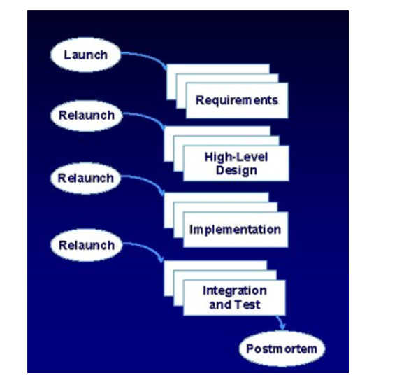
Team Software Process (CO1)

Slide 52
Team Software Process (CO1)
Activities of TSP-
Project Launch: It reviews project objective and describes the TSP structure and content. It assigns need and roles to the team members and describes the customers need statement.
High Level Design: it creates the high-level design, specifies the design, inspects the design and develops the integration plan.
3) Implementation: This uses the PSP to implement the modules and the functions.
4) Integration and Testing: Testing builds and integrates the system.
5) Postmortem: Writes the cycle report and produces peer and team review.

Slide 53
Team Software Process (CO1)
TSP Advantages
Defines roles and responsibilities for each team member.
Track quantitative project data (about productivity and quality).
Identifies a team process that is appropriate for the project and a strategy for implementing the process.
Defines local standards that apply to the team‘s software engineering work(team decides software process on its own)
Continually assesses risks and mitigating them,
Tracks, manages and reports project status.

Slide 54
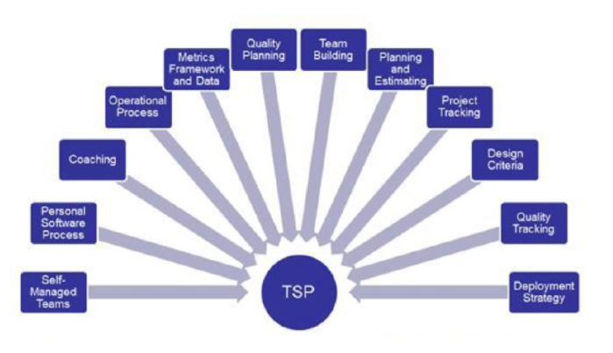
Team Software Process (CO1)

Slide 55
Emergence of Software Engineering (CO1)
Software engineering discipline is the result of advancement in the field of technology. In this section, we will discuss various innovations and technologies that led to the emergence of software engineering discipline.
Early Computer Programming
As we know that in the early 1950s, computers were slow and expensive. Though the programs at that time were very small in size, these computers took considerable time to process them.
They relied on assembly language which was specific to computer architecture. Thus, developing a program required lot of effort. Every programmer used his own style to develop the programs.
2. High Level Language Programming (FORTRAN to Python)
With the introduction of semiconductor technology, computers became smaller, faster, cheaper, and reliable than their predecessors.

Slide 56
Emergence of Software Engineering (CO1)
3. Control Flow Based Design
To help the programmer to design programs having good control flow structure, flowcharting technique was developed.
In flowcharting technique, the algorithm is represented using flowcharts. A flowchart is a graphical representation that depicts the sequence of operations to be carried out to solve a given problem.
Structured programming became a powerful tool that allowed programmers to write moderately complex programs easily.
The purpose of structured programming is to make the software code easy to modify when required.

Slide 57
Emergence of Software Engineering (CO1)
4. Data-Flow Oriented Design
In this technique, the flow of data through business functions or processes is represented using Data-flow Diagram (DFD).
IEEE defines a data-flow diagram (also known as bubble chart and work-flow diagram) as ‘a diagram that depicts data sources, data sinks, data storage, and processes performed on data as nodes, and logical flow of data as links between the nodes.’

Slide 58
Emergence of Software Engineering (CO1)
5. Object Oriented Design
Object-oriented design technique has revolutionized the process of software development. It not only includes the best features of structured programming but also some new and powerful features such as encapsulation, abstraction, inheritance, and polymorphism.
These new features have tremendously helped in the development of well-designed and high-quality software.

Slide 59
Software Project (CO1)
Project
A project is well-defined task, which is a collection of several operations done in order to achieve a goal (for example, software development and delivery). A Project can be characterized as:
Every project may has a unique and distinct goal.
Project is not routine activity or day-to-day operations.
Project comes with a start time and end time.
Project ends when its goal is achieved hence it is a temporary phase in the lifetime of an organization.
Project needs adequate resources in terms of time, manpower, finance, material and knowledge-bank.

Slide 60
Software Project (CO1)
What is a Software Project?
A Software Project is the complete procedure of software development from requirement gathering to testing and maintenance, carried out according to the execution methodologies, in a specified period of time to achieve intended software product.
Purpose of Software Project
To meet specific needs of a specific client or organization (known as custom software).
To meet a perceived need of some set of potential users (known as commercial software ).
For personal use (e.g. a scientist may write software to automate a tedious task).

Slide 61
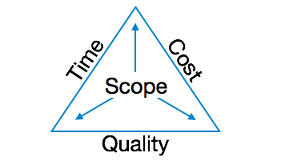
Software Project (CO1)
The image above shows triple constraints for software projects. It is an essential part of software organization to deliver quality product, keeping the cost within client’s budget constrain and deliver the project as per scheduled. There are several factors, both internal and external, which may impact this triple constrain triangle. Any of three factor can severely impact the other two.
Therefore, software project management is essential to incorporate user requirements along with budget and time constraints.

Slide 62
Software Product (CO1)
Software Products are nothing but software systems delivered to the customer with the documentation that describes how to install and use the system.
In certain cases, software products may be part of system products where hardware, as well as software, is delivered to a customer.
Software products are produced with the help of the software process. The software process is a way in which we produce software.

Slide 63
Software Product(CO1)
Types of Software Product
Software products fall into two broad categories:
Essential characteristics of Well-Engineered Software Product:
Software Product
Generic Product
Customized Product

Slide 64
Software Product (CO1)
A well-engineered software product should possess the following essential characteristics:
Efficiency: The software should not make wasteful use of system resources such as memory and processor cycles.
Maintainability: It should be possible to evolve the software to meet the changing requirements of customers.
Dependability: It is the flexibility of the software that ought to not cause any physical or economic injury within the event of system failure. It includes a range of characteristics such as reliability, security, and safety.
In time: Software should be developed well in time.

Slide 65
Software Process(CO1)
Software process is the related set of activities and process that are involved in developing and evolving a software system.
or
A set of activities whose goal is the development or evolution of software.
or
A software process is a set of activities and associated results which produce a software product.
or
– A set of interrelated activities, which transform inputs into outputs (ISO 12207/8402)
used by an organization or project to plan, manage, execute, monitor, control and improve any software related activity

Slide 66
Software Process
There are four fundamental process activities which are common to all software processes. These activities are
Software specification:- the functionality of the software and constraints on its operation must be defined.
Software development:- the software to meet the specification must be produced by using a certain programming language.
Software validation:- the software must be validated to ensure that it does and what the customer wants.
Software evolution:- the software must evolve to meet the changing customer needs.
Different software processes organize these activities in different ways and are described at different levels of detail. The timing of the activities varies, as does the result of each activity. Different organizations may use different process to produce the same type of product. However some process are more suitable than other for same types of application.

Slide 67
Software Process
The software industry considers software development as a process. According to Booch and Rambough A process defines who is doing what, when and how to reach a certain goal ?
Software Engineering is a field, which combines process, methods and tools for the development of software.
The concept of process is the main step in the software engineering approach. When these activities are performed in specific sequence in accordance with ordering constraints, the desired results are produced.

Slide 68
Conventional Engineering Process vs Software Engineering Process
Conventional Engineering Process : It is a engineering process which is highly based on empirical knowledge and is about building cars, machines and hardware.
Software Engineering Process : It is a engineering process which is mainly related to computers and programming and developing different kinds of applications through the use of information technology.

Slide 69
Similarity with conventional Engineering Process
Conventional Engg.(steps to solve problem)
Problem formulation and analysis.
Search for alternatives.
Decision and specification
Implementation
Testing
Software Engg.(steps to solve problem)
Understand the problem(analysis and specification)
Alternative solution
Plan a solution(modeling and s/w design)
Carry out the plan(coding)
Examine the result for accuracy(testing and quality assurance)
Both develop tool and technique for high quality useful product

Slide 70
Comparison with conventional Engg. Process
Conventional Engg. Process
Software Engg. Process
Software Engg. Process
Based on science, mathematics and empirical knowledge
Construct real artifact.
Main concern is cost of production and reliability measure by time of failure.
1000 years old.
Conventional engineering are able to precisely describe and measure material they used for their work.
Use meter, volt and other units of measurement.
Maintenance try to apply known and tested principle.
Based on computer science, information science and discrete mathematics.
Construct non real(abstract) artifact.
Main concern is cost of development and reliability is measured by no. of error per thousands lines of source code.
50 years old.
Software engineering are not get able to precisely describe and measure material they used and result of their work.
LOC, function point or complexity measure is used to capture the amount of software created.
Maintenance apply new and untested elements in software project.

Slide 71
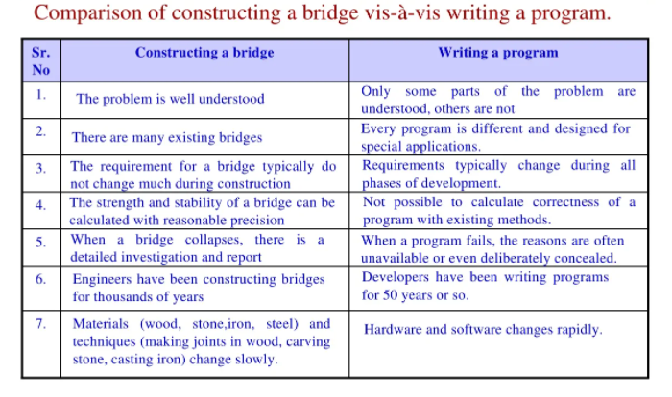
Comparison with conventional Engg. Process

Slide 72
Software Quality Attributes
Software Quality Attributes
Software Quality Attributes are features that facilitate the measurement of performance of a software product by Software Testing professionals.
Software Quality Attributes are:
Customer Satisfaction, Functionality, Reliability, Robustness, Usability, Efficiency, Maintainability, Portability, Security and Protection.
Customer Satisfaction: Customer must be satisfied by the product delivered to them and it must contain all the specifications demanded by the customer.
Functionality: Functionality is the ability of the system to do the work for which it was intended.

Slide 73
Software Quality Attributes
Reliability : Reliability of a software system derives from
– Correctness – Availability
The behavior over time for the fulfillment of a given specification depends on the reliability of the software system.
Robustness: Robustness reduces the impact of operational mistakes, erroneous input data, and hardware errors.
Usability: Usability is the degree to which a software can be used by specified consumers to achieve quantified objectives.

Slide 74
Software Quality Attributes
Efficiency: ability of a software system to fulfill its purpose with the best possible utilization of all necessary resources (time, storage, transmission channels, and peripherals).
Maintainability: Maintainability = suitability for debugging (localization and correction of errors) and for modification and extension of functionality.
The maintainability of a software system depends on its:
– Readability – Extensibility – Testability

Slide 75
Software Quality Attributes
Portability: The ease with which a software system can be adapted to run on computers other than the one for which it was designed.
Structuredness: System-dependent elements are collected in easily interchangeable program components.
The main technique for achieving portable software is to isolate system dependencies
Security and Protection: Security measures such as spyware, firewalls and malware detection must be incorporated in order to establish Security and protection in a software.

Slide 76
Software Development Life Cycle
SDLC stands for “Software Development Life Cycle”.
It describes the various phases involved in the software development process using which we can create and maintain a software application efficiently.
It is used to facilitate the development of large s/w product in a systematic, well defined and cost-effective manner.
It is the period of time that start when a software product is conceived and end when the product is no longer available for use.
Purpose of SDLC
Help to understand entire process.
Enforces a structured approach to development.
Enables planning of resources in advance.
Enables subsequent controls of them.
Aids management to track progress of system.
SDLC can be decided min. 5 and max. 9 phases. Each phase identified along with Entry and Exit Criteria.

Slide 77
Software Development Life Cycle
SDLC includes the following phases –
Requirement Gathering & Analysis
Requirement gathering is one of the most critical phases of SDLC. This phase marks the basis of the whole software development process. All the business requirements are gathered from the client in this phase. A formal document is created which defines the purpose of the product and marks the guidelines for the other phases of the life cycle.
Designing
Software design or we can say a layout is prepared in this phase according to the requirements specified in the previous step (requirement gathering). In this phase, the requirements are broken down into multiple modules like login module, signup module, main functionality, etc. This design document is considered as the input for the next implementation phase.

Slide 78
Software Development Life Cycle
Implementation
In this phase, the actual development gets started. The developer writes code using different languages and platforms, depending on the need of the product. The main stakeholder in this phase is the development team.
Testing
After the completion of the development phase, testing begins. Here testers test the software and provide appropriate feedback to the developing team. The tester checks whether the software developed fulfills the specified requirements as stated in the requirement phase. Both functional and non-functional testing are performed in this phase before the final delivery to the client.

Slide 79
Software Development Life Cycle
Deployment
After the testing gets completed, the product is handed over to the client. This phase involves making the software product live in the production environment.
Maintenance
In this phase, the maintenance of the software product is taken care of. It involves making changes to the software that are required to make it operational with the change in infrastructure, configuration, etc, over a period of time.

Slide 80
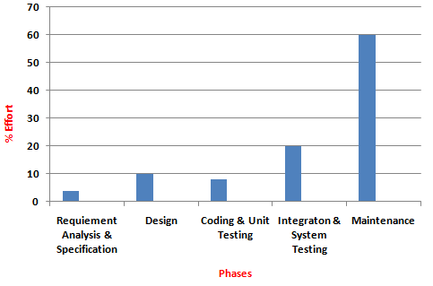
% Effort Involved in SDLC Phases
In development phases Integration and System Testing requires maximum effort.
Maintenance Phase requires maximum (60%) effort.

Slide 81
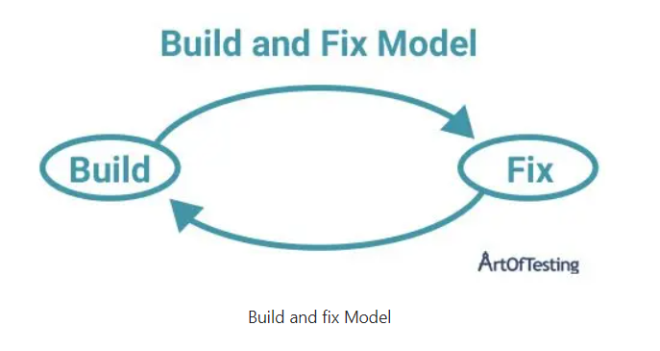
Build and Fix Model (CO1)
In the build and fix model (also referred to as an ad hoc model), the software is developed without any specification or design.
An initial product is built, which is then repeatedly modified until it (software) satisfies the user.
That is, the software is developed and delivered to the user.
Although this approach is good for smaller applications, there are several issues in this approach like – no defined processes, no documentation, maintenance is very difficult, higher cost and low-quality deliverable in case of larger projects, etc.

Slide 82
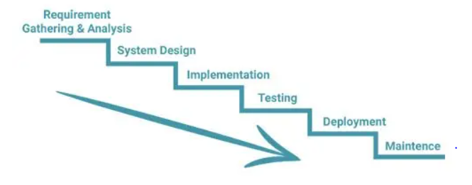
Waterfall Model (CO1)
The waterfall model is one of the earliest models of the Software Development Life Cycle.
The different phases in the waterfall model progress sequentially downwards, resembling a waterfall, hence the name – “Waterfall Model”.
Once a phase of the development cycle gets completed, there is no way to go back to that phase again in order to correct it or make any desired change.

Slide 83
Waterfall Model (CO1)
Waterfall Model Advantages/Pros
It is easy to understand and implement.
There are specific deliverables in each phase of the life cycle.
All the activities to be performed in each phase are clearly defined.
It is perfectly suitable for short projects where all the requirements are predefined and understood clearly.

Slide 84
Waterfall Model (CO1)
Waterfall Model Disadvantages/Cons
As this model requires freezing of requirements, hence, it not suitable for projects in which changes in requirements are possible or inevitable.
The working model is only visible in the later phases of the life cycle i.e. after the implementation phase.
Any correction or update required in the previous phase is not possible.

Slide 85
Prototype Model (CO1)
In the case of the prototype model, a working model of the application is created with limited functionality.
The prototype is then shown to the customer to get the feedback.
This helps in better requirement understanding.
It have 2 types in general :
1) Throwaway prototype
2) Evolutionary prototype

Slide 86
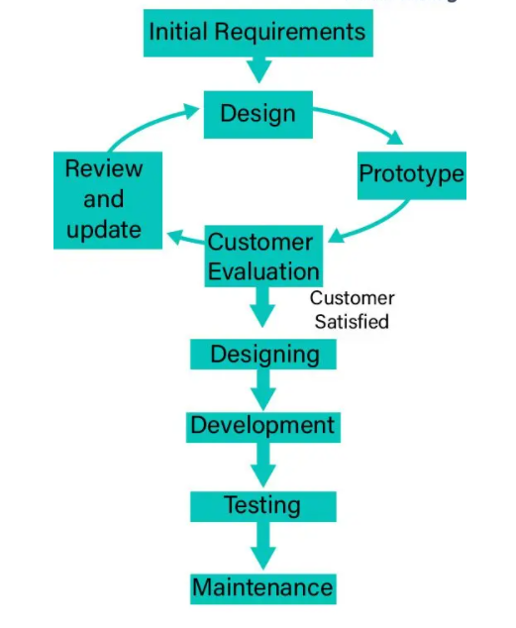
Prototype Model (CO1)

Slide 87
Prototype Model (CO1)
Prototype Model Advantages/Pros
Customer satisfaction gets improved as they can see the working software early in the initial phases.
It is easier to figure out any missing requirements and incorporate them.
The developed prototype can also be reused by developers in the project.

Slide 88
Prototype Model (CO1)
Prototype Model Disadvantages/Cons
There can be a lack of documentation, since, both the development team as well as the customer rely on the evaluation and feedback of the prototype.
Overall cost and time can increase due to prototype creation and evaluation.
There can be uncertainty in the number of iterations that may be required before the prototype gets finally accepted by the customer.

Slide 89
Spiral Model
The Spiral Model is the combination of the iterative software development model and the waterfall model.
The most important feature of the model is that even after the project starts, it has the ability to manage and mitigate unknown risks. Hence, it is advisable to use this model for large and complex projects.
This model has four stages – planning, risk analysis, engineering, and the review phase. A project passes through all these stages repeatedly.

Slide 90
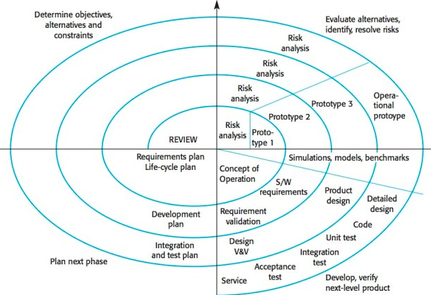
Spiral Model

Slide 91
Spiral Model
Spiral Model Advantages
The spiral model is perfect for projects that are large and complex in nature as continuous prototyping and evaluation help in mitigating any risk.
Because of its risk handling ability, the model is best suited for projects which are very critical like software projects related to health domain, space exploration, etc.
Since customer gets to see a prototype in each phase, so there are higher chances of customer satisfaction.

Slide 92
Spiral Model
Spiral Model Disadvantages
Because of the prototype development and risk analysis in each phase, it is very expensive and time taking.
It is not suitable for a simpler and smaller project because of the multiple phases.
Project deadlines can be missed since the number of phases is unknown in the beginning and frequent prototyping and risk analysis can make things worse.

Slide 93
Evolutionary development Model
Evolutionary model approaches to improve the classic waterfall model by providing scope of feedback and improvement at every stage of the system development.
Therefore, every stage should be taken as a separate evolutionary phase.
This model is useful for complex projects where all functionality must be delivered at one time, but the requirements are unstable or not well understood at the beginning.

Slide 94
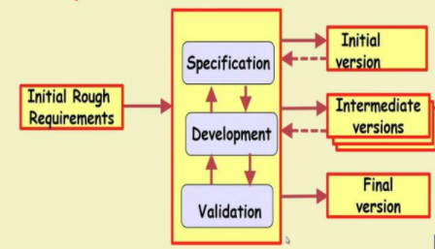
Evolutionary development Model

Slide 95
Evolutionary development Model
Advantage:
Used when it is not necessary to provide minimal version of the system quickly.
Model are useful for project using new technology that is not well understood.
Used for complex project where all functionality must be delivered at one time, but requirements are unstable or not well understood at the beginning.

Slide 96
Evolutionary development Model
Disadvantage:
Not possible to develop fixed cost estimates and static schedule due to uncertainty.
Developer don’t have the sufficient knowledge to understand and implement the software.
It is hard to split the problem into several versions that would be acceptable to the customer and which can be incrementally implemented and delivered.

Slide 97
Iterative Enhancement Model (CO1)
In the case of the Iterative model, we start with the implementation of a small set of software requirements to develop the first version of the software.
After that, we iteratively implement and incorporate new changes resulting in the creation of new versions of the software until the complete system gets created and deployed.

Slide 98
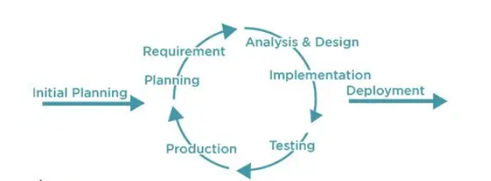
Iterative Enhancement Model

Slide 99
Iterative Enhancement Model (CO1)
Iterative Model Advantages
Working functionality can be developed very quickly.
It is easier to test and develop due to smaller iterations.
Customer’s feedback can be incorporated easily in the new versions.
Risks can be identified and resolved during iterations.

Slide 100
Iterative Enhancement Model(CO1)
Iterative Model Disadvantages
Comparatively more resources are required in this model.
It is not advisable to use this model in smaller projects.
Adherence to the project deadline is very difficult because of the multiple versions due to either change in requirements or due incorporation of the client’s feedback.

Slide 101
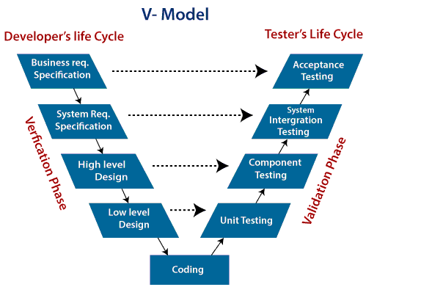
V Process Model(CO1)
V-Model also referred to as the Verification and Validation Model. In this, each phase of SDLC must complete before the next phase starts. It follows a sequential design process same as the waterfall model. Testing of the device is planned in parallel with a corresponding stage of development.

Slide 102
V Process Model(CO1)
Verification: It involves a static analysis method (review) done without executing code. It is the process of evaluation of the product development process to find whether specified requirements meet with help inspections, reviews and walk- through.
Validation: It involves dynamic analysis method (functional, non-functional), testing is done by executing code. Validation is the process to classify the software after the completion of the development process to determine whether the software meets the customer expectations and requirements

Slide 103
SDLC(CO1)
SDLC includes the following phases
Project initiation and planning/ recognition of need/ preliminary investigation
Project identification and selection/ feasibility study.
Organizational feasibility.
Economic feasibility.
Technical feasibility.
Operational feasibility.
Project analysis.
System design.
Output design.
Input design.
File design.
Processing design.
Detailed system documentation.
Coding.

Slide 104
Software Development Life Cycle (CO1)
It is used to facilitate the development of large s/w product in a systematic, well defined and cost effective manner.
It is the period of time that start when a software product is conceived and end when the product is no longer available for use.
Purpose of SDLC
Help to understand entire process.
Enforces a structured approach to development.
Enables planning of resources in advance.
Enables subsequent controls of them.
Aids mgmt. to track progress of system.
SDLC can be decided min. 5 and max. 9 phases. Each phase identified along with Entry and Exit Criteria.

Slide 105
SDLC(CO1)
6. Testing.
Unit Testing (testing each module isolation from other modules)
System Testing
Alpha Testing (performed by development Team)
Beta Testing (performed by friendly set of customers)
Acceptance Testing (performed by customer himself)
7. Implementation
8. Maintenance.
Corrective maintenance.
Adaptive maintenance.
Perfective maintenance.
Preventive maintenance.

Slide 106
% Effort Involved in SDLC Phases(CO1)
Maintenance Phase requires max.(60%) effort.
In development phases Integration and System Testing requires max. effort
Source: Software Engg. Book by Rajeev Mall

Slide 107
Conclusion about SDLC models
Software development models have evolved over the years from the initial “build and fix” model to Spiral and Agile models, which are more suited for the complex business needs and processes.
So, depending on the budget, requirement, risk and time, we can choose between the available models.

Slide 108
Agile Methodology
Agility
Agility is the capability to efficiently and effectively adapt to an ever changing environment.
Agility can be defined at different levels: personal, departmental or organizational.
Note that it is not possible to implement agility directly. Agility is a property of a system that is present to some varying extent, depending on how the system operates.
One can identify three drivers which will cause a system to become more agile: flow, learning and collaboration.
Agile emphasizes iterative development, frequent feedback, and continuous improvement to deliver high-quality software that meets customer needs effectively. Here are the key characteristics and principles of agile methodology:

Slide 109
Agile Methodology
Agility
Agility is the capability to efficiently and effectively adapt to an ever changing environment.
Agility can be defined at different levels: personal, departmental or organizational.
Note that it is not possible to implement agility directly. Agility is a property of a system that is present to some varying extent, depending on how the system operates.
One can identify three drivers which will cause a system to become more agile: flow, learning and collaboration.
Agile emphasizes iterative development, frequent feedback, and continuous improvement to deliver high-quality software that meets customer needs effectively. Here are the key characteristics and principles of agile methodology:

Slide 110
Agile Methodology: Key Characteristics
a) Iterative and Incremental Development
Software is developed in small, manageable units called iterations (or sprints).
Each iteration produces a working version of the software, allowing continuous improvement.
b) Customer Collaboration
Agile encourages frequent communication with customers to understand evolving needs.
Unlike traditional models, where requirements are fixed at the start, Agile allows modifications based on user feedback.
c) Adaptive Planning
Agile is highly flexible and allows teams to adjust plans based on changing requirements.
Unlike Waterfall, where planning is rigid, Agile embraces uncertainty.
d) Continuous Feedback and Improvement
Teams gather feedback from stakeholders after every iteration.
This helps in early issue detection and continuous enhancement.
e) Cross-functional Teams
Agile promotes self-organizing teams with developers, testers, designers, and business analysts working together.
Teams collaborate daily to ensure smooth progress.

Slide 111
Agile Methodology: Key Characteristics
f) Working Software Over Documentation
Agile values functional software more than extensive documentation.
However, essential documentation is maintained for clarity.
g) Time-boxed Development (Sprints)
Work is divided into fixed-length sprints (usually 1-4 weeks).
Each sprint focuses on delivering a usable feature or module.
h) Testing Throughout Development
Agile follows continuous testing rather than testing only after coding.
Testing is integrated into each iteration, ensuring better quality.
i) Collaboration and Communication
Daily stand-up meetings (Scrum meetings) are held to discuss progress, roadblocks, and next steps.
Developers, testers, and business stakeholders work closely together.
j) Minimal Risk and High Quality
Since Agile delivers small increments, it reduces the risk of project failure.
Continuous testing and feedback improve the quality of the final product.

Slide 112
Agile Methodology:Values and Principles
Four Core Values
Individuals and interactions over processes and tools.
Working software over comprehensive documentation.
Customer collaboration over contract negotiation.
Responding to change over following a plan.
Twelve Agile Principles
Customer satisfaction through early and continuous delivery.
Embrace changing requirements, even late in development.
Deliver working software frequently (weeks rather than months).
Business stakeholders and developers must collaborate daily.
Motivated individuals build great software—trust and support them.
Face-to-face communication is the best form of interaction.
Working software is the primary measure of progress.
Maintain a sustainable pace—avoid burnout.
Continuous technical excellence and good design improve agility.
Simplicity—the art of maximizing work not done—is essential.
Self-organizing teams produce the best solutions.
Teams should regularly reflect on their work and adjust accordingly.

Slide 113
Agile Methodology
Common Agile Frameworks and Methodologies:
Scrum: Scrum is one of the most widely used agile frameworks, featuring roles such as Product Owner, Scrum Master, and Development Team. It emphasizes short, time-boxed iterations called "sprints" and includes ceremonies like Sprint Planning, Daily Standups, Sprint Review, and Sprint Retrospective.
Kanban: Kanban is a visual management method for agile teams, often represented as a board with columns representing different stages of work. Work items (e.g., user stories or tasks) are represented as cards that move through the columns as work progresses. Kanban emphasizes continuous flow and limiting work in progress (WIP).
Extreme Programming (XP): XP is an agile methodology that emphasizes technical excellence and customer involvement. It includes practices such as Test-Driven Development (TDD), Pair Programming, Continuous Integration, and Collective Code Ownership.

Slide 114
Agile Methodology
Scrum is the type of Agile framework. It is a framework within which people can address complex adaptive problem while productivity and creativity of delivering product is at highest possible values. Scrum uses Iterative process.
Silent features of Scrum are:
Scrum is light-weighted framework
Scrum emphasizes self-organization
Scrum is simple to understand
Scrum framework help the team to work together

Slide 115
Sprint
Sprint: A Sprint is a time box of one month or less. A new Sprint starts immediately after the completion of the previous Sprint.
Release: When the product is completed, it goes to the Release stage.
Sprint Review: If the product still has some non-achievable features, it will be checked in this stage and then passed to the Sprint Retrospective stage.
Sprint Retrospective: In this stage quality or status of the product is checked.
Product Backlog: According to the prioritize features the product is organized.
Sprint Backlog: Sprint Backlog is divided into two parts Product assigned features to sprint and Sprint planning meeting.
Advantage of using Scrum framework:
Scrum framework is fast moving and money efficient.
Scrum framework works by dividing the large product into small sub-products. It’s like a divide and conquer strategy
In Scrum customer satisfaction is very important.
Scrum is adaptive in nature because it have short sprint.
As Scrum framework rely on constant feedback therefore the quality of product increases in less amount of time

Slide 116
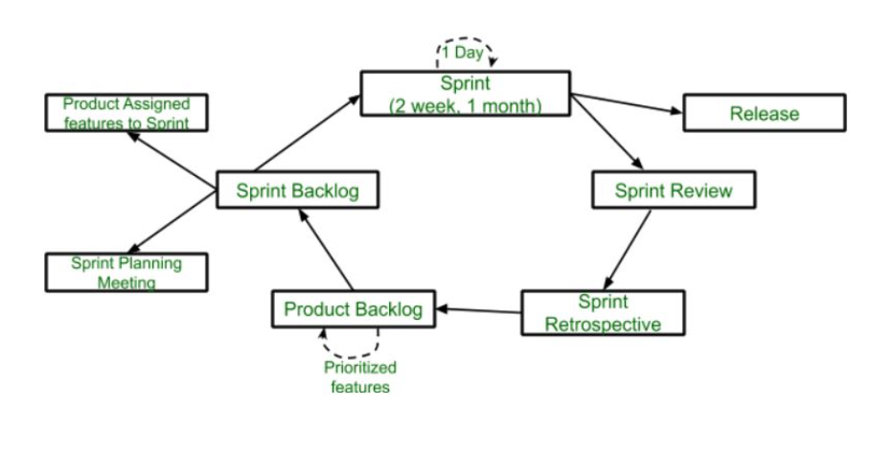
SCRUM

Slide 117
Sprint: Case Study
E-commerce Website Development
Step 1: Product Backlog
The Product Owner creates a Product Backlog with prioritized features:
User login and registration
Product search functionality
Shopping cart feature
Secure payment gateway
Order tracking system
Customer reviews and ratings
Admin panel for inventory management

Slide 118
Sprint
Step 2: Sprint Planning Meeting
The Scrum Team selects high-priority features for the next sprint (2 weeks duration):
User login and registration
Product search functionality
Shopping cart feature
These selected features move to the Sprint Backlog.
Step 3: Sprint Execution (2 Weeks)
The development team starts working on the selected tasks.
Daily Stand-up Meetings are held to discuss progress and blockers.
Example breakdown:
Day 1-3: Develop user registration and login.
Day 4-6: Implement product search functionality.
Day 7-9: Integrate shopping cart feaure.
Day 10-12: Testing and debugging.
Day 13-14: Final review and minor fixes.

Slide 119
Sprint
Step 4: Sprint Review
The team presents completed features to stakeholders.
Example Outcome:
Login and search functionalities are approved.
Shopping cart feature requires UI improvements (noted for the next sprint).
Step 5: Release
Approved features are deployed to a staging server or directly to production.
Example Outcome:
Login and search functions are live, while cart improvement is planned for the next sprint.

Slide 120
Sprint
Step 6: Sprint Retrospective
The team discusses:
What went well?
Smooth login system implementation.
Testing completed on time.
What can be improved?
Shopping cart needs UI improvements.
Better task distribution to avoid last-minute rush.
Step 7: Updating the Product Backlog
The Product Owner updates the backlog based on:
Feedback from the Sprint Review.
New requirements from stakeholders.
Improvements identified in the Sprint Retrospective.
Example Update:
“Improve shopping cart UI” added to the backlog.
Next sprint will focus on secure payment integration and order tracking.

Slide 121
Sprint
Cycle Repeats
The next sprint starts with new tasks from the Product Backlog.
The process continues until the full e-commerce website is built in multiple iterations.

Slide 122
Scrum framework
Disadvantage of using Scrum framework:
Scrum framework do not allow changes into their sprint.
Scrum framework is not fully described model. If you wanna adopt it you need to fill in the framework with your own details like Extreme Programming(XP), Kanban, DSDM.
It can be difficult for the Scrum to plan, structure and organize a project that lacks a clear definition.
The daily Scrum meetings and frequent reviews require substantial resources.

Slide 123
Scrum Master
Scrum Master acts as the heart of the Scrum project. They need to perform responsibilities like:
Assure that the team meets its business objectives.
Foster a collaborative environment in the team.
Do the planning, team backlog grooming, sprint demo, and sprint retrospective.
Guide Scrum processes and help to maintain the integrity of Scrum values.
Promote improved engineering practices like TDD, automated testing, and continuous integration.
Make sure that every stakeholder should be present at the meeting at the given time.
Work with other team members to ensure that dependencies and risks are distributed across Scrum teams.
Conduct feasibility studies, write & validate specifications

Slide 124
Scrum Master
The Scrum Master is not a project manager. Both roles are different in the agile process. They will not guide a team in every phase of development. They are neither responsible for any technical decision nor for managing the business with clients. They will never lead the team or make decisions on behalf of the team.
Scrum Master must have multiple skills, including technical, Scrum process, and soft skills. They must know different techniques and practices to manage self-organizing teams. They should show honesty, integrity, trust, and respect for the team. They should have expertise in Agile, IT coaching, and presentation. Moreover, Scrum Master should be able to schedule meetings in such a way that it doesn’t affect the regular work of the team members.

Slide 125
Product Owner
A Product Owner is a person who is responsible for maximizing the value of the product resulting from the work of the Development Team. They are the primary stakeholders of the project and are responsible for defining the product vision, creating and maintaining the product backlog, and ensuring that the team understands the items in the product backlog to the level expected
The Product Owner is the sole person responsible for managing the product backlog. They are responsible for ensuring that the product backlog is in good shape and that it is ready for the next sprint ¹.
The Product Owner is responsible for defining the product vision and ensuring that the team understands it. They are responsible for communicating the vision to the team and ensuring that the team is aligned with the vision.
The Product Owner is responsible for prioritizing the items in the product backlog. They are responsible for ensuring that the items in the product backlog are prioritized based on their value to the customer.

Slide 126
Faculty Video Links, Youtube & NPTEL Video Links and Online Courses Details
Youtube/other Video Links
https://nptel.ac.in/courses/106/105/106105182/
https://www.youtube.com/watch?v=Z6f9ckEElsU&list=PL8751DA481F0F0D17
https://www.youtube.com/watch?v=fhKwJbmaCEg
https://www.youtube.com/watch?v=TcxA-h8o5P4
https://www.youtube.com/watch?v=e6HjDcd4U6U
https://www.youtube.com/watch?v=a7jDv_A25ZA
https://www.youtube.com/watch?v=rvTejAg_fbY

Slide 127
Daily Quiz
1) Software is
(a) Superset of programs (b) subset of programs
(c) Set of programs (d) none of the above
2) Which is NOT the part of operating procedure manuals?
(a) User manuals (b) Operational manuals
(c) Documentation manuals (d) Installation manuals
3) Product is
(a) Deliverables (b) User expectations
(c) Organization's effort in development (d) none of the above
4) To produce a good quality product, process should be
(a) Complex (b) Efficient
(c) Rigorous (d) none of the above

Slide 128
Daily Quiz
5) Project risk factor is considered in
(a) Waterfall model (b) Prototyping model
(c) Spiral model (d) Iterative enhancement model
6) SDLC stands for
(a) Software design life cycle (b) Software development life cycle
(c) System development life cycle (d) System design life cycle
8) Build and fix model has
(a) 3 phases (b) 1 phase
(c) 2 phases (d) 4 phases
9) Waterfall model is not suitable for
(a) small projects (b) requirement change with time
(c) complex projects (d) both b and c

Slide 129
MCQ(CO1)
1. Software is considered to be collection of ____________.
programming code
associated libraries
documentations
All of the above
2. Which of the following is the Characteristics of good software?
A. Transitional
B. Operational
C. Maintenance
D. All of the above
3. Where there is a need of Software Engineering?
A. For Large Software
B. To reduce Cost
C. Software Quality Management
D. All of the above

Slide 130
MCQ(CO1)
4. Which of the following is the first step in SDLC framework?
A. Feasibility Study
B. Requirement Gathering
C. Communication
D. System Analysis
5. Waterfall model is not suitable for?
A. Small projects
B. Complex projects
C. Accommodating changes
D. Maintenance Projects
6. Which one of the following is a functional requirement?
A. Maintainability
B. Portability
C. Business needs
D. Reliability

Slide 131
MCQ(CO1)
7.Agile Software Development is based on
Incremental Development
Iterative Development
Linear Development
Both Incremental and Iterative Development
8. Agility is defined as the ability of a project team to respond rapidly to a change.
True
False
9. Which of the following does not apply to agility to a software process?
Uses incremental product delivery strategy
Only essential work products are produced
Eliminate the use of project planning and testing
All of the mentioned

Slide 132
MCQ(CO1)
10.What is the first step in the software development lifecycle?
A. System Design
B. Coding
C. System Testing
D. Preliminary Investigation and Analysis

Slide 133
Glossary Questions
Software engineering
Software Components
Software Crisis
Software Engineering Processes
Software Quality Attributes
Deliverables
Milestones
Productivity Metrics

Slide 134
Weekly Assignment(CO1)
Explain software crisis. Given an example.
Explain the different component of software?
Describe the characteristics of Software? Explain with suitable diagram.
What do you mean by Software Development Life Cycle? Discuss all the phases of waterfall model with suitable diagram and compare its requirements with others models.
Discuss the iterative enhancement software ware development model
Define following software terminologies: Deliverables, milestones, metrics, Productivity
How does “project risk” factor affect spiral model of software development?
What do mean by software process model? Discuss spiral model in details with suitable diagram and also explain its merits and demerits.
How does “project risk” factor affect spiral model of software development?

Slide 135
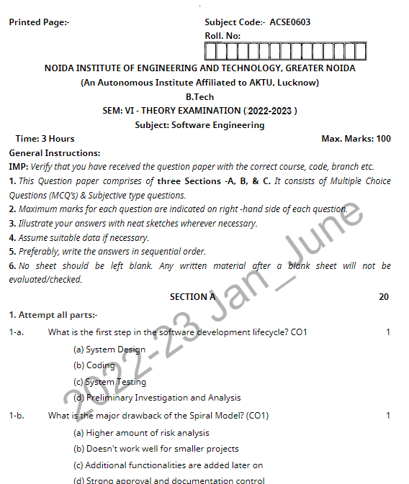
Old Question Papers(CO1)

Slide 136
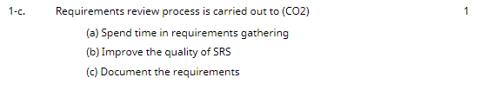
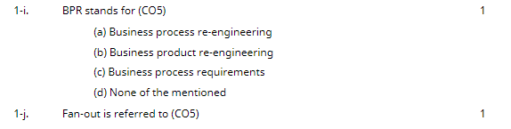
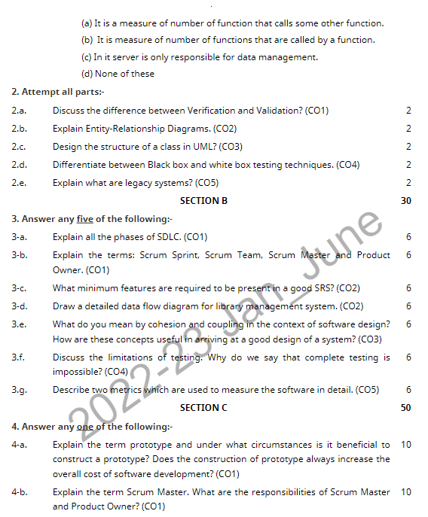
Old Question Papers(CO1)

Slide 137
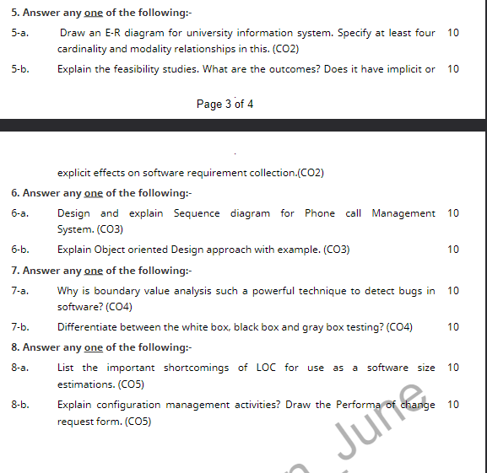
Old Question Papers(CO1)

Slide 138
Expected Questions for University Exam(CO1)
What is SDLC?
Explain the role of TSP in software development?
What do you understand by software product, software project and software process.
How does “project risk” factor affect spiral model of software development?
What is the need for software emergence.
Discuss the iterative enhancement software ware development model
Define following software terminologies: Deliverables, milestones, metrics, Productivity
How does “project risk” factor affect spiral model of software development?
What do mean by software process model? Discuss spiral model in details with suitable diagram and also explain its merits and demerits.
How does “project risk” factor affect spiral model of software development?

Slide 139
Recap
In this unit we get to know about Software and its Components and characteristics.
Software Crisis and Software Engineering Processes
Similarity and Differences from Conventional Engineering Processes
Software Quality Attributes
Software Development Life Cycle (SDLC) Models
Water Fall Model,
Prototype Model,
Spiral Model, Evolutionary Development Models,
Iterative Enhancement Models

Slide 140
Summary
Software Components
Software Characteristics
Software Crisis
Software Engineering Processes
Similarity and Differences from Conventional Engineering Processes
Software Quality Attributes
Software Development Life Cycle (SDLC) Models
Water Fall Model,
Prototype Model,
Spiral Model, Evolutionary Development Models,
Iterative Enhancement Models

Slide 141
References
Text books:
KK Aggarwal and Yogesh Singh, Software Engineering, New Age International Publishers 3RDEdition(December 11, 2008)
2. RS Pressman, Software Engineering: A Practitioners Approach, McGraw Hill. 7thEdition.(14-Jan-2022)
3. Rajib Mall, Fundamentals of Software Engineering, PHI Publication.4th Edition.(1 January 2014)
Reference Books:
Pankaj Jalote, Software Engineering, Wiley. (1 January 2010)
2. Ghezzi, M. Jarayeri, D. Manodrioli, Fundamentals of Software Engineering, PHI Publication. 2nd Edition. (1January 2007)
3. Kassem Saleh, “Software Engineering”, Cengage Learning. (2009)
4. Ian Summerville, Software Engineering, Addison Wesley. 9th Edition.(29 October 2017

